Slide 1
Course Name: Database Management System
Course Code: CS116
Dr. Praveen Kantha

Slide 2
Transaction Processing

Slide 3
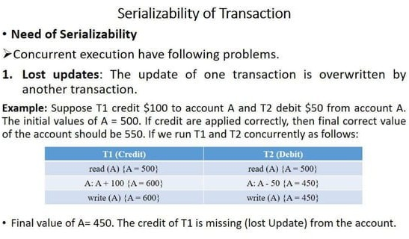

Slide 4
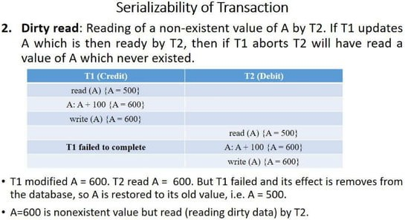

Slide 5
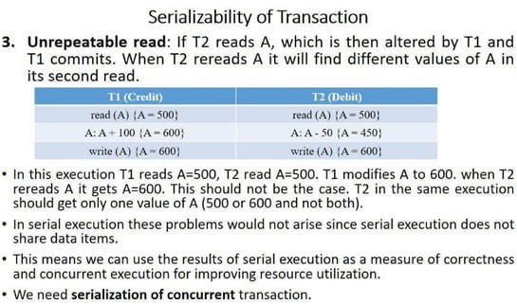

Slide 6
Serializability
It ensures that the final state of the database is the same as if the transactions had been executed in serial order or one after another.
On the other hand, it gives surety to the concurrent execution of multiple transactions.
A serializability schedule in DBMS ensures that concurrent transactions produce the same final result as if they were executed one after the other.
It also helps to maintain the data consistency and integrity.
Types of Serializability
There are two types of serializability:
Conflict Serializability
View Serializability

Slide 7
Conflict Serializability:
When either of a conflict operations such as Read-Write or Write-Read or Write-Write is implemented on the same data item at the same time within different transactions then the schedule holding such transactions is said to be a conflict schedule.
The conditions for such a conflict schedule are:
The conflict operations are to be implemented on the same data item.
The conflict operations (RW, WR, WW) must take place within different transactions.
At least one of the conflict operations must be the write operation.
Two Read operations will not create any conflict.

Slide 8
To conclude, let’s take two operations on data: "a". The conflicting pairs are:
READ(a) - WRITE(a)
WRITE(a) - WRITE(a)
WRITE(a) - READ(a)

Slide 9
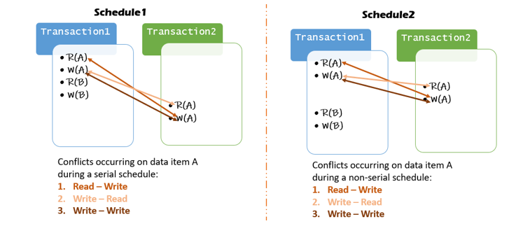
Example:
Consider 2 schedules, Schedule1 and Schedule2,
Schedule2 (a non-serial schedule) is considered to be conflict serializable when its conflict operations are the same as that of Shedule1 (a serial schedule).

Slide 10
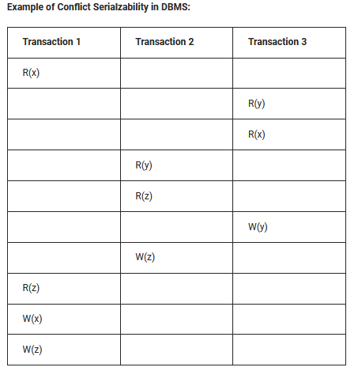

Check whether the given schedule S is conflict serializable or not.
S: R1(x), R3(y), R3(x), R2(y), R2(z), W3(y), W2(z),R1(z),W1(x),W1(z)
Let’s see how a precedence graph looks like of above schedule.
In the above precedence graph, we can see that there is no cycle present in the graph. So, we can say that the above schedule is conflict serializable.
The conflicting pairs are:
READ(a) - WRITE(a)
WRITE(a) - WRITE(a)
WRITE(a) - READ(a)

Slide 11
Let’s see how a precedence graph looks like of above schedule.
Conflict Serializable
It will
Serializable
It will
Consistant

Slide 12


For making serializable, we follow In degree=0
means, we find the vertex in which direction not coming to any edge.
Here T2 VERTEX in which direction not
coming to any edge. Now remove the T2 vertex and their edge and their direction towards T1 and T3, so result is below
Here T3 VERTEX in which direction not
coming to any edge. Now remove the T3 vertex and their edge and their direction towards T1 , so the result is below
The FINAL Serial order will be :
T2 ->T3-> T1

Slide 13
T2 ->T3-> T1
Serial Serializable Schedule
Transaction 1 | Transaction 2 | Transaction 3
 | R(y)
 | R(z)
 | W(z)
 |  | R(y)
 |  | R(x)
 |  | W(y)
R(x)
R(z)
W(x)
W(z)

Slide 14
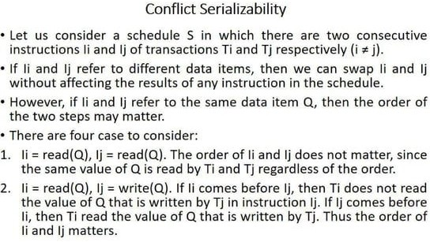

Slide 15
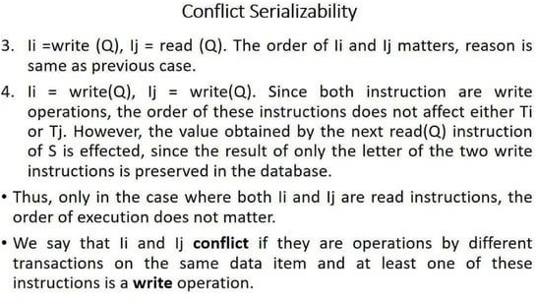

Slide 16
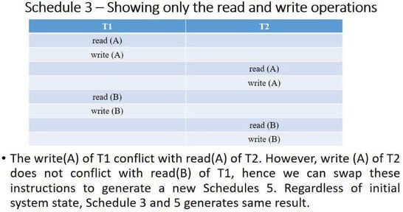

Slide 17
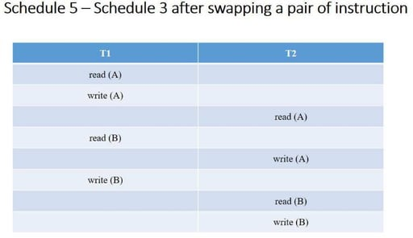

Slide 18
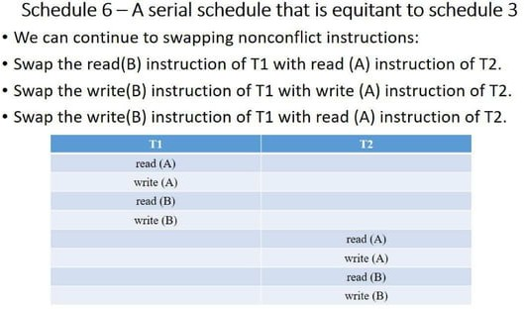

Slide 19
View Serializability
It is a process used to check whether the given schedule is view serializable or not.
A schedule will be viewed as serializable if it is viewed as equivalent to a serial schedule.
If a schedule is conflict serializable, then it will be viewed as serializable.
The view serializable which does not conflict serializable contains blind writes.

Slide 20
Why use View Serializability
T1
T2
T1 | T2 | T3
R(A)
 | W(A)
W(A)
 |  | W(A)
T3
Here, loop / Cycle exists, so no conflict serializable.
If a loop /cycle exists but it can be serial schedule or consistent that can be further checked by View Serializability. That is why we use View Serializability

Slide 21
Blind Writes
T1 | T2 | T3
R(A)
 | W(A)
W(A)
 |  | W(A)
If there is no read that happens prior to the first write then it is said to be a blind write.
W2(A) is a blind write, as there is no read before write [R2(A) before W2(A)]
W3(A) is not a blind write, as a read happens before write [R3(A) before W3(A)]

Slide 22
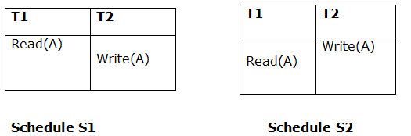
Consider two schedules S1 and S2, where the same set of transactions participates in both schedules. The schedules S1 and S2 are said to be view equivalent if three conditions are met:
1. Initial Read :
If T_{i} reads the initial value of A in S1, then T_{i} also reads the initial value of A in S2

Slide 23
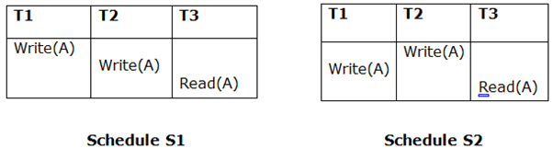
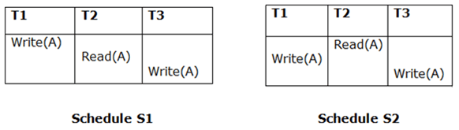
2. Updated Read
If T_{i} reads the value of A written by T_{j} in S1, then T_{i} also reads value of A written
by T_{j} in S2
Above two schedules are not view equal because, in S1, T3 is reading A updated by T2 and in S2, T3 is reading A updated by T1.
3. Final Write
If T_{i} writes the final value of A in S1, then T_{i} also writes final value of A in S2

Slide 24
The concept of view equivalence leads to the concept of view serializability.
We can say that a schedule S is view serializable if it is view equivalent to a serial schedule.

Slide 25
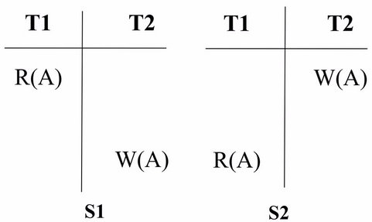
View Equivalent Schedule
Consider two schedules S1 and S2, they are said to be view equivalent if following conditions are true :
The initial read must be same.
S1 : T1 reads A from the Database.
S2 : T1 reads A from T2 not from Database because in S2 value of A rewritten in T2.
So,
S1 S2

Slide 26
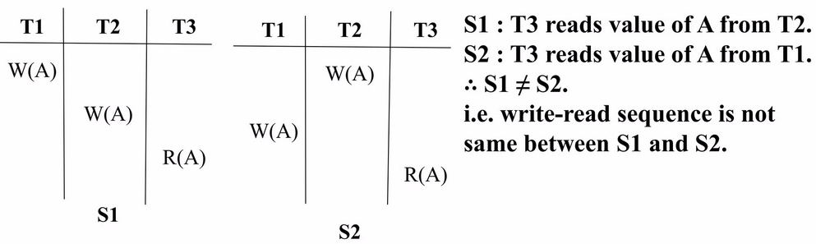
• There are two transactions say T_{i} and T_{j}, The schedule S1 and S2 are view equivalent if in Schedule S1, T_{i} reads A that has been updated by T_{j}, and in schedule S2, T_{i} must read A from T_{j}. i.e. write-read(WR) sequence must be same between S1 and S2.

Slide 27
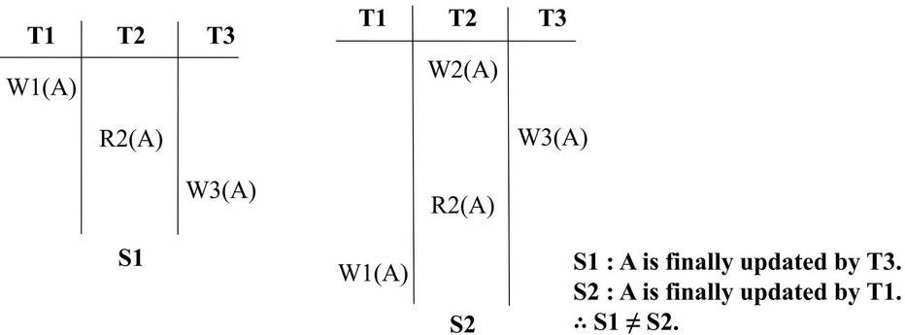
Final write operations should be the same between S1 and S2.

Slide 28
Check whether the schedule is view serializable or not?
S:R2(B); R2(A); R1(A); R3(A); W1(B); W2(B); W3(B)
Solution: With 3 transactions, the total number of schedules possible =3!=6.
<T1 T2 T3>.
<T1 T3 T2>
<T2 T3 T1>
<T2 T1 T3>
<T3 T1 T2>
<T3 T2 T1>
« Step 1: Final Updation (Write) on data item (For each transaction)
A:-
B:T1 T2 T3

Slide 29
Since the final updation on B is made by T3, so the transaction T3 must execute after transactions T1 and T2.
Therefore, (T1,T2) — T3
Step 2 : Initial Read + Which transaction updates after read?
A: T2 T1 T3
B: T2 Tl
The transaction T2 reads B initially which is updated by T1. So T2 must execute before T1.
Hence, T2 — T1

Slide 30
﻿
Step 3: Write Read Sequence (WR) :
No need to check here.
Hence, view equivalent serial schedule is :
T2 → T1 → T3

Slide 31
﻿
Check whether the schedules is View serializable or not?
• R2(A); R1(A); W1(C); R3(C); W1(B); R4(B); W3(A); R4(C); W2(D);
R2(B); W4(A); W4(B)
Solution
• The data items on which operations are occurring are A,B,C,D.
Step 1: Check for Final Updation (Write) on data items
A: T3 T4
B: T1 T4
C: T1
D: T2

Slide 32
﻿Since the final updation on A is made by T4, so the transaction T4 must execute after T3 transaction.
• Since the final updation on B is made by T4, so the transaction T1 must execute before T3 transaction.
Dependency 1: (T1 T3) → T4 (1)
Step 2: Initial Read
• Initial Read + Which transaction updates after read?
A: T2 T1 T3
• The transaction T2 and T1 reads A initially from DB which is updated by T3. So T3 must execute after T1 and T2.
Dependency 2: (T2 T1)→ T3 (2)
From (1) and (2) dependencies, another dependency can be concluded as :
Dependency 3: (T1 T2)→ T3 → T4 (3)

Slide 33
﻿
Step 3: Write Read Sequence (WR):
WR Seq. : Dependencies:
W1(C) R3(C) T1→ T3
W1(C) R4(C) T1→ T4
W1(B) R4(B) T1 → T4
W1(B) R2(B) T1 → T2
⇒ T1 → (T2 T3 T4) (4)
From (3) and (4) dependencies, We conclude the view equivalent serial schedule is :
T1 → T2 → T3 → T4

Slide 34
﻿
Check whether the given schedule is view serializable. Justify your answer.
Step 1: Check for Final Updation (Write) on data item Q
(T4, T3,T5)
DEPENDENCY: (T4,T3)→ T5 ......(1)
T3 | T4 | T5
R(Q)
 | W(Q)
W(Q) |  | W(Q)

Slide 35
﻿
Step 2: Initial Read
Initial Read + Which transaction updates after read?
T3 T4, T5
• The transaction T3 reads Q initially from DB which is updated by T4 & T5. So T3 must execute before T4 and T5.
Dependency 2: T3 → (T4, T5) (2)
Step 3: Write Read Sequence (WR)
• No need to check here because W(Q) in T4 is not read by a transaction.
• From dependency (1) T4 must happen before T3 & from dependency (2) T3 must happen before T4. This results in cyclic dependency which cannot be resolved.
• Hence the given schedule is not view serializable.

Slide 36
Recoverability
Recoverability is a property of database systems that ensures that, in the event of a failure or error, the system can recover the database to a consistent state.
Recoverability guarantees that all committed transactions are durable and that their effects are permanently stored in the database.

Slide 37
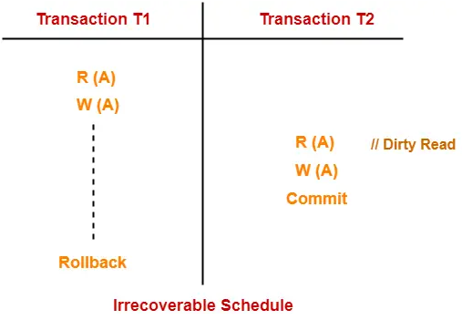
Irrecoverable Schedules-
If in a schedule,
A transaction performs a dirty read operation from an uncommitted transaction
And commits before the transaction from which it has read the value
then such a schedule is known as an Irrecoverable Schedule.
Here,
T2 performs a dirty read operation.
T2 commits before T1.
T1 fails later and roll backs.
The value that T2 read now stands to be incorrect.
T2 can not recover since it has already committed.

Slide 38
Recoverable Schedules
If in a schedule,
A transaction performs a dirty read operation from an uncommitted transaction
And its commit operation is delayed till the uncommitted transaction either commits or roll backs
then such a schedule is known as a Recoverable Schedule.

Slide 39
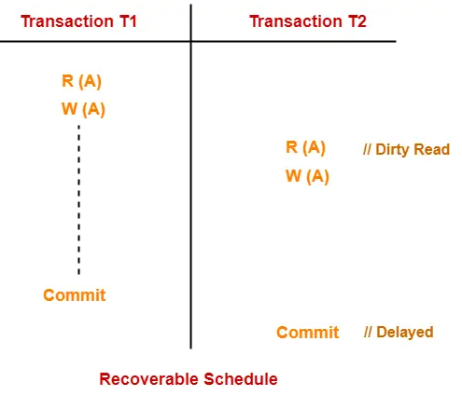
Here,
T2 performs a dirty read operation.
The commit operation of T2 is delayed till T1 commits or roll backs.
T1 commits later.
T2 is now allowed to commit.
In case, T1 would have failed, T2 has a chance to recover by rolling back.
Here,
The commit operation of the transaction that performs the dirty read is delayed.
This ensures that it still has a chance to recover if the uncommitted transaction fails later.

Slide 40
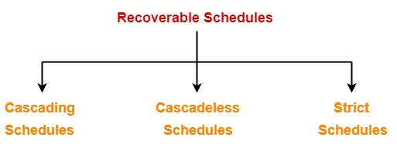
Types of Recoverable Schedule:

Slide 41
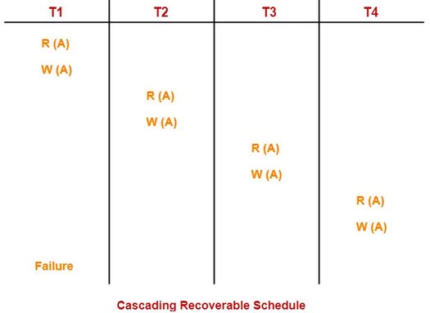
Cascading Schedule-
If in a schedule, the failure of one transaction causes several other dependent transactions to rollback or abort, then such a schedule is called as a Cascading Schedule or Cascading Rollback or Cascading Abort.
It simply leads to the wastage of CPU time.
Here,
Transaction T2 depends on transaction T1.
Transaction T3 depends on transaction T2.
Transaction T4 depends on transaction T3.
In this schedule,
The failure of transaction T1 causes transaction T2 to rollback.
The rollback of transaction T2 causes the transaction T3 to rollback.
The rollback of transaction T3 causes the transaction T4 to rollback.
Such a rollback is called as a Cascading Rollback.

Slide 42
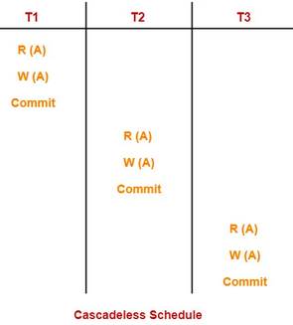
Cascadeless Schedule
If in a schedule, a transaction is not allowed to read a data item until the last transaction that has written it is committed or aborted, then such a schedule is called as a Cascadeless Schedule.
A Cascadeless schedule allows only committed read operations.
It avoids cascading rollback and thus saves CPU time.
Cascadeless schedule allows only committed read operations.

